Slide 1
Data Science Capstone Project
-Hasmitha
-09/2021
Github link: https://github.com/hasmithavasireddy/IBM-Data-Science-Professional-Certification

Slide 2

OUTLINE
Executive Summary
Introduction
Methodology
Results
Conclusion
Appendix/Miscellaneous

Slide 3
Executive Summary
Data collection is from a public API- SpaceX, which is basically a SpaceX Wikipedia page.
I have created a column for labels called ‘class’ which classifies successful landings.
Explored data using SQL, Data Visualization, Folium maps, and dashboards.
Later have gathered relevant columns that has to be used as features.
Then has changed all categorical variables to binary using one hot encoding.
Standardized data and used GridSearchCV to find best parameters for machine learning models.
Visualize accuracy score of all models.
Specially Four machine learning models were produced:
1)Logistic Regression
2)Support Vector Machine and Decision Tree Classifier
3)K Nearest Neighbors.
Similar results were produced with an accuracy rate of around 83.33%.
All the models were predicted successful landings.
Extra amount of data is required for better model determination and accuracy.

Slide 4
INTRODUCTION & DELIVERABLES
Background data:
Commercial Space Age is Here
Space X has best pricing ($62 million vs. $165 million USD)
Largely due to ability to recover part of rocket (Stage 1)
Space Y wants to compete with Space X
Task & deliverables:
Space Y tasks us to train a machine learning model to predict successful Stage 1 recovery

Slide 5
Methodology
Data collection methodology:
Combined data from SpaceX public API and SpaceX Wikipedia page
Perform data wrangling
Classifying true landings as successful and unsuccessful otherwise
Perform exploratory data analysis (EDA) using visualization and SQL
Perform interactive visual analytics using Folium and Plotly Dash.
Perform predictive analysis using classification models
Tuned models using GridSearchCV

Slide 6
Data Collection Overview
Data collection process involved a combination of API requests from Space X public API and web scraping data from a table in Space X’s Wikipedia entry.
The next slide will show the flowchart of data collection from API and the one after will show the flowchart of data collection from Webscraping.
Space X API Data Columns:
FlightNumber, Date, BoosterVersion, PayloadMass, Orbit, LaunchSite, Outcome, Flights, GridFins,
Reused, Legs, LandingPad, Block, ReusedCount, Serial, Longitude, Latitude
Wikipedia Webscrape Data Columns:
Flight No., Launch site, Payload, PayloadMass, Orbit, Customer, Launch outcome, Version Booster, Booster landing, Date, Time

Slide 7
Data collection- Space
Step-1
Step-2
Step-33
Request the space X API’S.
.JSON file + Lists
(Launch Site, Booster Version, Payload Data)
Json_normalize to the DataFrame from JSON.
Filter the data to only including the FALCON-9 launches.
Cast the dictionary to a Data Frame.
Retrieve the dictionary with relevant data.
Impute missing PayloadMass values with its mean.

Slide 8
Data Collection- Web Scraping
Step-1
Step-2
Request Wikipedia html
BeautifulSoup html5lib Parser
Find the launch information html table.
Cast a dictionary to the DataFrame.
Iterate through table cells to extract the data into the dictionary.
Create a dictionary.

Slide 9
Data Wrangling
Create a training label with landing outcomes where successful = 1 and failure = 0.
Outcome column has two components:
‘Mission Outcome’
‘Landing Location’
New training label column ‘class’ with a value of 1 if ‘Mission Outcome’ is True and 0 otherwise.
Value Mapping:
True ASDS, True RTLS, & True Ocean – set to -> 1
None None, False ASDS, None ASDS, False Ocean, False RTLS – set to -> 0

Slide 10
EDA with SQL
Loaded data set into IBM DB2 Database.
Queried using SQL Python integration.
Queries were made to get a better understanding of the dataset.
Queried information about launch site names, mission outcomes, various pay load sizes of customers and booster versions, and landing outcomes.

Slide 11
Build an interactive map with Folium
Folium maps mark Launch Sites, successful and unsuccessful landings, and a proximity example to key locations: Railway, Highway, Coast, and City.
This allows us to understand why launch sites may be located where they are. Also visualizes successful landings relative to location.

Slide 12
Build a Dashboard with Plotly Dash
Dashboard includes a pie chart and a scatter plot.
Pie chart can be selected to show distribution of successful landings across all launch sites and can be selected to show individual launch site success rates.
Scatter plot takes two inputs: All sites or individual site and payload mass on a slider between 0 and 10000 kg.
The pie chart is used to visualize launch site success rate.
The scatter plot can help us see how success varies across launch sites, payload mass, and
Booster version category.

Slide 13
Predictive analysis (Classification)
Step-1
Step-2
Split label column ‘Class’ from dataset.
Fit and Transform Standard Scaler
Train_test_split data
Score models on split test set
Use GridSearchCV Decision Tree, and KNN models
GridSearchCV (cv=10) to find optimal parameters
Confusion Matrix for all models
Barplot to compare scores of models

Slide 14
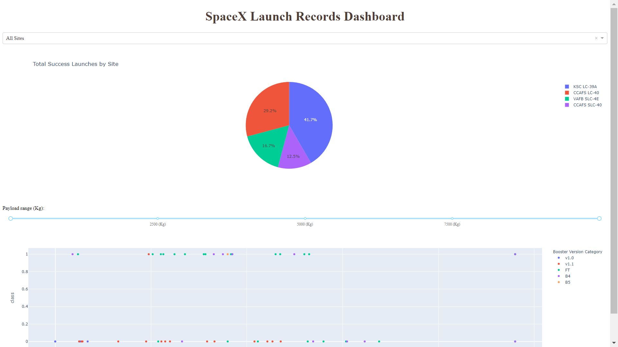
RESULTS
This is a preview of the Plotly dashboard.
The following sides will show the results of EDA with visualization, EDA with SQL, Interactive Map with Folium, and finally the results of our model with about 83% accuracy.

Slide 15
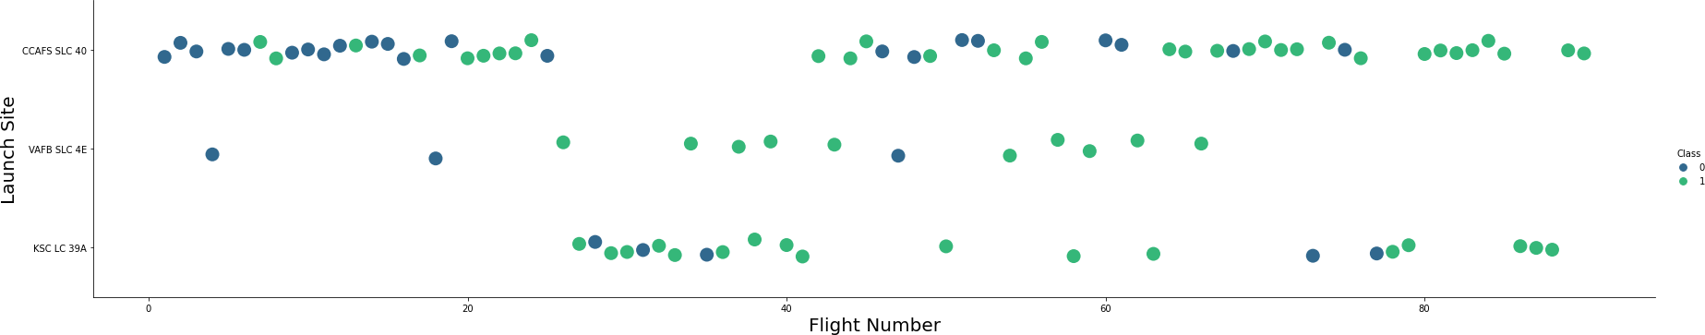
Flight Number vs Launch Site
Green indicates successful launch; Purple indicates unsuccessful launch.
Graphic suggests an increase in success rate over time (indicated in Flight Number).
Likely a big breakthrough around flight 20 which significantly increased success rate.
CCAFS appears to be the main launch site as it has the most volume.

Slide 16
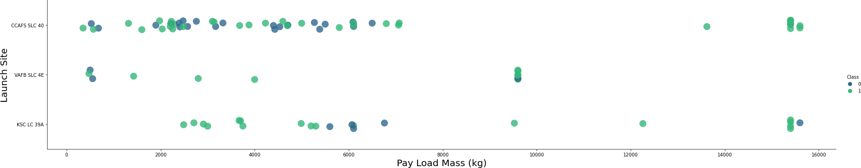
Payload vs Launch Site
Green indicates successful launch; Purple indicates unsuccessful launch.
Payload mass appears to fall mostly between 0-6000 kg.
Different launch sites also seem to use different payload mass.

Slide 17
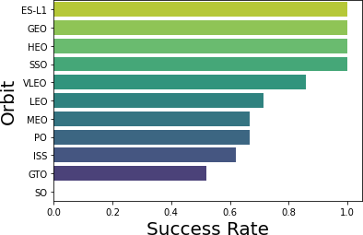
Success rate vs Orbit Type
Success Rate Scale with 0 as 0% 0.6 as 60% 1 as 100%.
ES-L1 (1), GEO (1), HEO (1) have 100% success rate (sample sizes in parenthesis)
SSO (5) has 100% success rate
VLEO (14) has decent success rate and attempts SO (1) has 0% success rate
GTO (27) has the around 50% success rate but largest sample

Slide 18
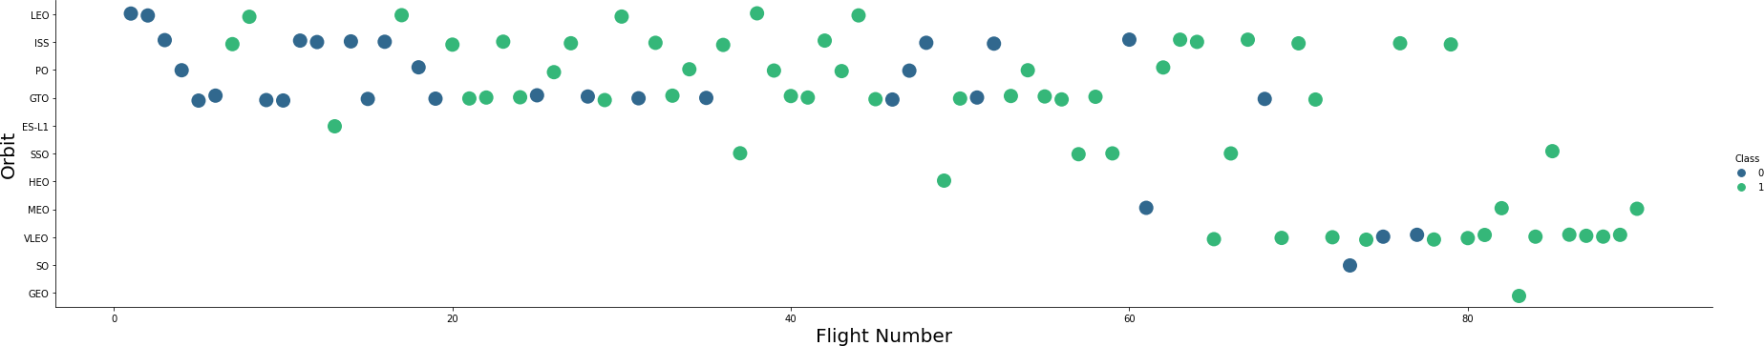
Flight Number vs Orbit Type
Green indicates successful launch; Purple indicates unsuccessful launch.
Launch Orbit preferences changed over Flight Number.
Launch Outcome seems to correlate with this preference.
SpaceX started with LEO orbits which saw moderate success LEO and returned to VLEO in recent launches SpaceX appears to perform better in lower orbits or Sun-synchronous orbits.

Slide 19
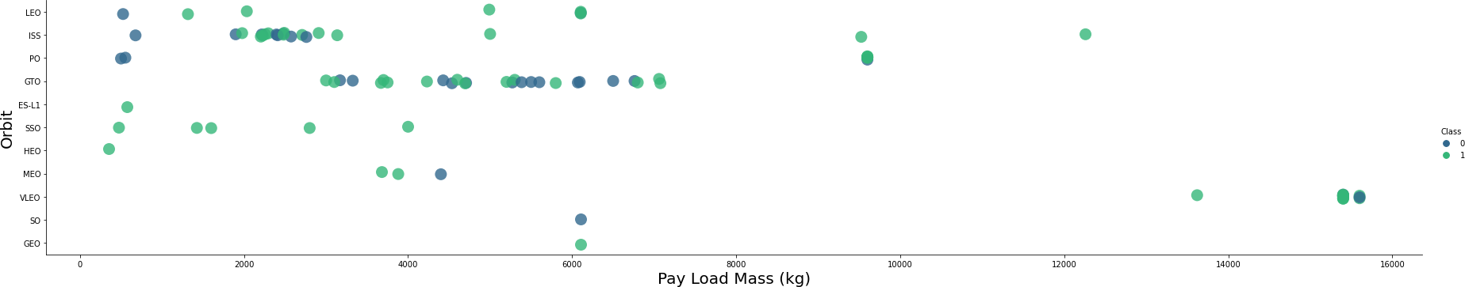
PayLoad vs. Orbit Type
Green indicates successful launch; Purple indicates unsuccessful launch.
Payload mass seems to correlate with orbit LEO and SSO seem to have relatively low payload mass.
The other most successful orbit VLEO only has payload mass values in the higher end of the range

Slide 20
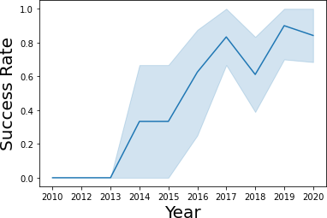
Launch Success Yearly Trend
95% confidence interval (light blue shading)
Success generally increases over time since 2013 with a slight dip in 2018 Success in recent years at around 80%

Slide 21
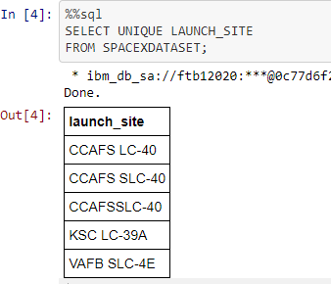
All Launch Site Names
Query unique launch site names from database.
CCAFS SLC-40 and CCAFS SLC-40 likely all represent the same launch site with data entry errors.
CCAFS LC-40 was the previous name.
Likely only 3 unique launch_site values:
1) CCAFS SLC-40
2)KSC LC-39A
3)VAFB SLC-4E

Slide 22
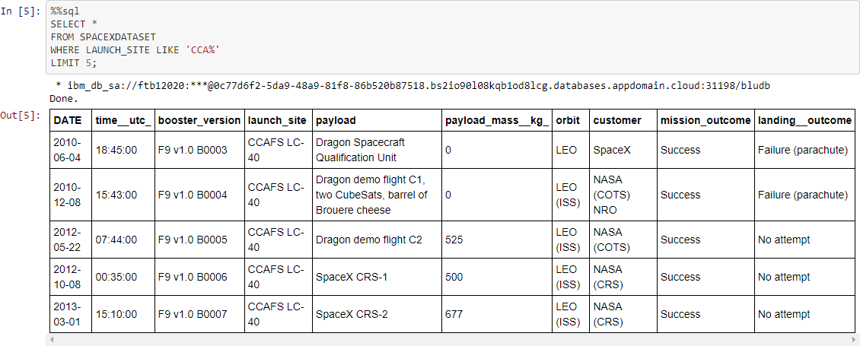
Launch Site Names Beginning with `CCA`
First five entries in database with Launch Site name beginning with CCA.

Slide 23
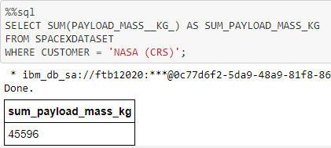
Total Payload Mass from NASA
This query sums the total payload mass in kg where NASA was the customer. CRS stands for Commercial Resupply Services which indicates that these payloads were sent to the International Space Station (ISS).

Slide 24
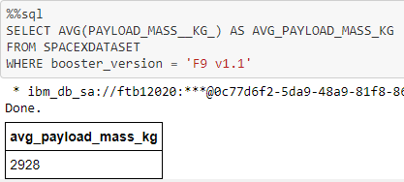
Average Payload Mass by F9 v1.1
This query calculates the average payload mass or launches which used booster version F9 v1.1 Average payload mass of F9 1.1 is on the low end of our payload mass range

Slide 25
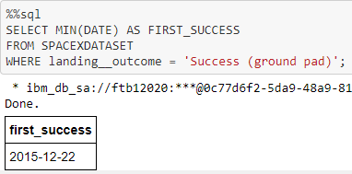
First Successful Ground Pad Landing Date
This query returns the first successful ground pad landing date. First ground pad landing wasn’t until the end of 2015. Successful landings in general appear starting 2014.

Slide 26
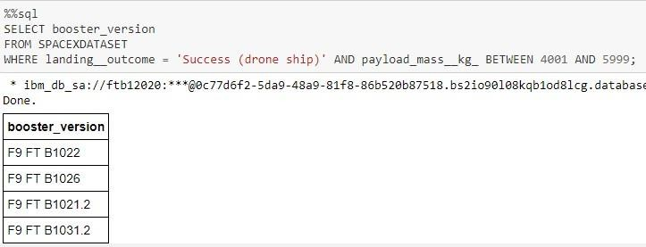
Successful Drone Ship Landing with Payload Between 4000 and 6000
This query returns the four booster versions that had successful drone ship landings and a payload mass between 4000 and 6000 non-inclusively.

Slide 27
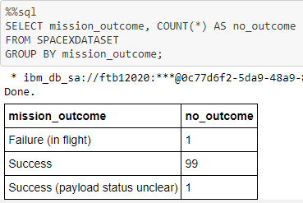
Total Number of Each Mission Outcome
This query returns a count of each mission outcome.
SpaceX appears to achieve its mission outcome nearly 99% of the time.
This means that most of the landing failures are intended.
Interestingly, one launch has an unclear payload status and unfortunately one failed in flight.

Slide 28
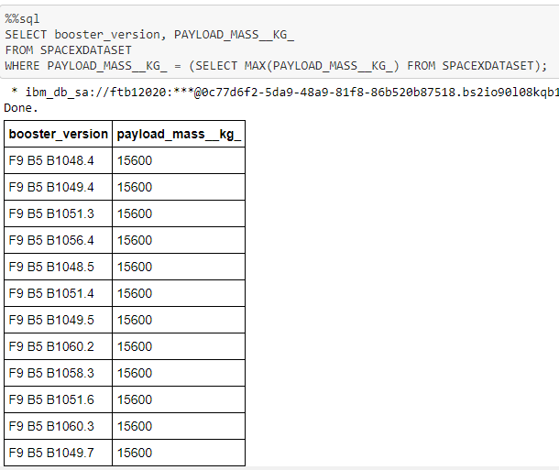
Boosters that Carried Maximum Payload
This query returns the booster versions that carried the highest payload mass of 15600 kg.
These booster versions are very similar and all are of the F9 B5 B10xx.x variety.
This likely indicates payload mass correlates with the booster version that is used.

Slide 29
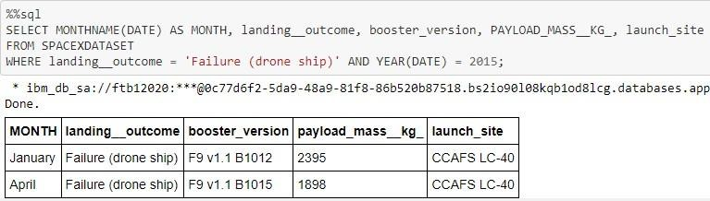
2015 Failed Drone Ship Landing Records
This query returns the Month, Landing Outcome, Booster Version, Payload Mass (kg), and Launch site of 2015 launches where stage 1 failed to land on a drone ship.
There were two such occurrences.

Slide 30
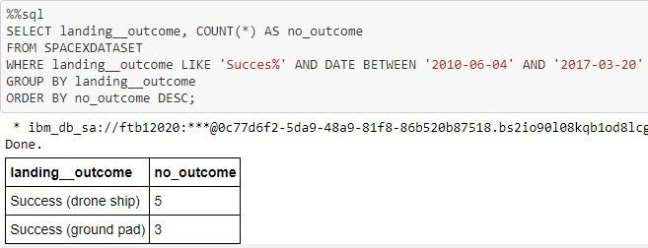
Ranking Counts of Successful Landings Between 2010-06-04 and 2017-03-20
This query returns a list of successful landings and between 2010-06-04 and 2017-03-20 inclusively.
There are two types of successful landing outcomes: drone ship and ground pad landings.
There were 8 successful landings in total during this time period.

Slide 31
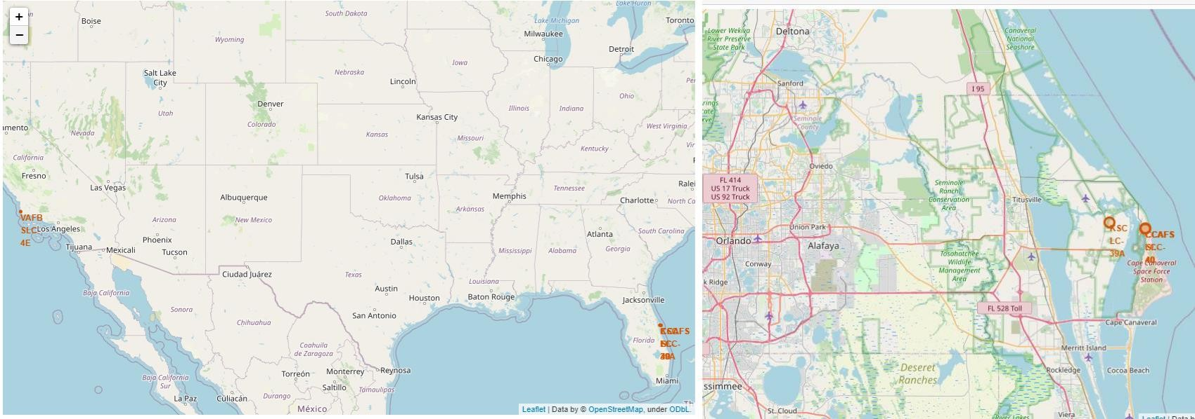
Interactive Map with Folium
Launch Site Locations
The left map shows all launch sites relative US map.
The right map shows the two Florida launch sites since they are very close to each other.
All launch sites are near the ocean.

Slide 32
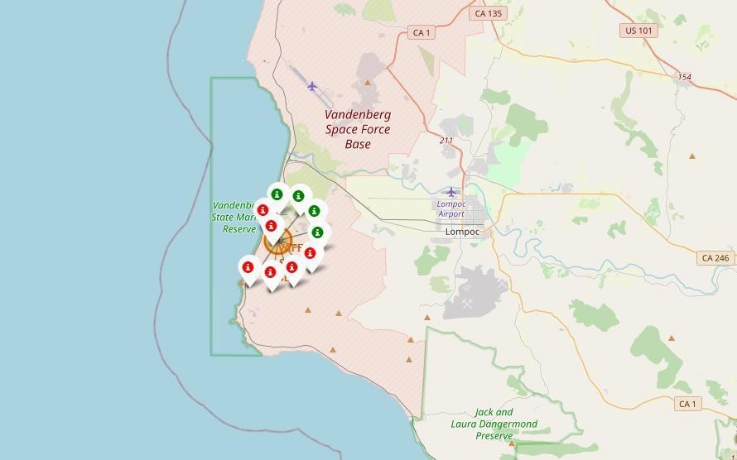
Color-Coded Launch Markers
Clusters on Folium map can be clicked on to display each successful landing (green icon) and failed landing (red icon).
In this example VAFB SLC-4E shows 4 successful landings and 6 failed landings.

Slide 33
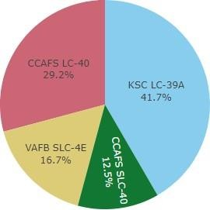

Build a Dashboard with Plotly Dash
Successful Launches Across Launch Sites
This is the distribution of successful landings across all launch sites.
CCAFS LC-40 is the old name of CCAFS SLC-40 so CCAFS and KSC have the same amount of successful landings, but a majority of the successful landings were performed before the name change.
VAFB has the smallest share of successful landings. This may be due to smaller sample and increase in difficulty of launching in the west coast.

Slide 34
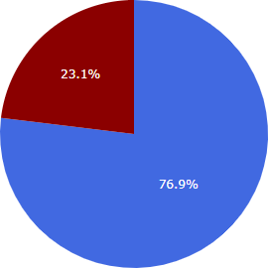

Highest Success Rate Launch Site
KSC LC-39A has the highest success rate with 10 successful landings and 3 failed landings.

Slide 35
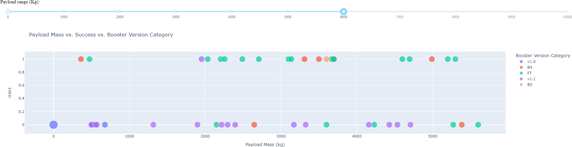
Payload Mass vs. Success vs. Booster
Version Category
Plotly dashboard has a Payload range selector.
However, this is set from 0-10000 instead of the max Payload of 15600.
Class indicates 1 for successful landing and 0 for failure.
Scatter plot also accounts for booster version category in color and number of launches in point size.
In this particular range of 0-6000, interestingly there are two failed landings with payloads of zero kg.

Slide 36
Predictive Analysis (Classification)
GRIDSEARCHCV(CV=10)
ON LOGISTIC REGRESSION
SVM
DECISION TREE
KNN

Slide 37
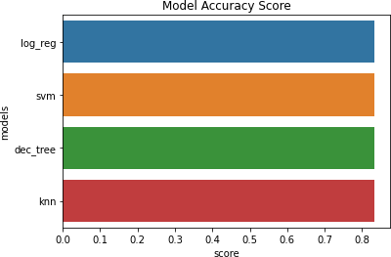
Classification Accuracy
All models had virtually the same accuracy on the test set at 83.33% accuracy.
It should be noted that test size is small at only sample size of 18.
This can cause large variance in accuracy results, such as those in Decision Tree Classifier model in repeated runs.
We likely need more data to determine the best model.

Slide 38
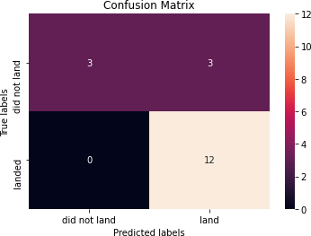
Confusion Matrix
Correct predictions are on a diagonal from top left to bottom right.
Since all models performed the same for the test set, the confusion matrix is the same across all models.
The models predicted 12 successful landings when the true label was successful landing.
The models predicted 3 unsuccessful landings when the true label was unsuccessful landing.
The models predicted 3 successful landings when the true label was unsuccessful landings (false positives).
Our models over predict successful landings.

Slide 39
CONCLUSION
Our task: to develop a machine learning model for Space Y who wants to bid against SpaceX
The goal of model is to predict when Stage 1 will successfully land to save ~$100 million USD.
Used data from a public SpaceX API and web scraping SpaceX Wikipedia page.
Created data labels and stored data into a DB2 SQL database Created a dashboard for visualization.
We created a machine learning model with an accuracy of 83%.
Allon Mask of SpaceY can use this model to predict with relatively high accuracy whether a launch will have a successful Stage 1 landing before launch to determine whether the launch should be made or not.
If possible more data should be collected to better determine the best machine learning model and improve accuracy.

Slide 40
APPENDIX
GitHub repository url: https://github.com/hasmithavasireddy/IBM-Data-Science-Professional-Certification
Instructors: Rav Ahuja, Alex Aklson, Aije Egwaikhide, Svetlana Levitan, Romeo Kienzler, Polong Lin, Joseph Santarcangelo, Azim Hirjani, Hima Vasudevan, Sai Shruthi Swaminathan, Saeed Aghabozorgi, Yan Luo
Special Thanks to All Instructors: https://www.coursera.org/professional-certificates/ibm-data-science?#instructors

